Slide 1
SOFTWARE RELIABILITY GROWTH MODELING: COMPARISON BETWEEN NON-LINEAR REGRESSION ESTIMATION AND MAXIMUM LIKELIHOOD ESTIMATOR PROCEDURES
Shreya Krishna
Cochin University of Science and Technology, CUCEK Campus, Kerala, INDIA

Slide 2
INTRODUCTION
Software Reliability and Software Reliability Growth Models
Software reliability may be defined as the probability that software would be functioning without failure under a given operating condition for a specified period of time.
In other words, it represents the potential of a computer program or code to perform a required function under stated conditions for a specified period of time.
Software reliability growth models (SRGMs) are used to determine the reliability growth. Reliability is analyzed using different models which may be based on Non-Homogeneous Poisson Process (NHPP), Markov process or Bayesian models.

Slide 3
Software Reliability Growth Models
Failure Rate
Models
-Jelinski & Moranda
-Schick & Wolverton
-Jelinski-Moranda
geometric
-Moranda geometric
Poisson
-Modified Schick & Wolverton
-Goel & Okumoto
imperfect debugging
NHPP
Models
-Gernalized Goel
-Goel & Okumoto
-Musa Okumoto
-Modified Duane
-Logistic Growth
-Gompertz
-Delayed S-shaped
-Inflection S-shaped
-Yamada exponential
-Yamada Raleigh
-Yamada imperfect
debugging Model
-PNZ Model
-Pham Zhang IFD
-Zhang-Teng-Pham
-P-Z Model
In this study, we try to evaluate methods which can be used satisfactorily to assess the reliability of the software in the automotive domain.
Two of the most widely used and recommended parameter estimation methodologies namely; Maximum-Likelihood-Estimation (MLE) and Non-linear-Regression (NLR) are compared.
The figure shows the classification of Software Reliability Models.

Slide 4
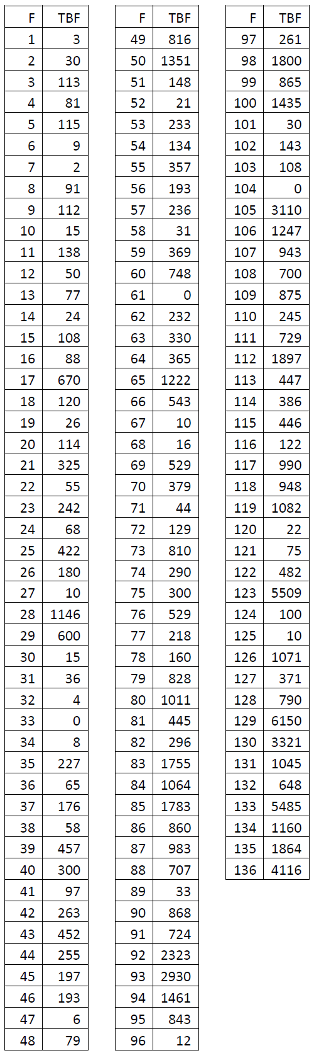
Least-square estimation is a method of performing regression analysis.
Unlike the maximum likelihood method, least square can be used when the joint distribution of the random variable is not specified.
In this study goodness of fit technique is used to compare some observed sample distribution with theoretical distribution.
The data used in the study is shown in the figure.

Slide 5
CASRE
The software CASRE is used to calculate the reliability using both the estimators.
CASRE is a software reliability measurement tool.
It incorporates the mathematical modeling capabilities of the Statistical Modeling and Estimation of Reliability Functions for Software (SMERFS).
CASRE provides graphs for comparison of various reliability evaluation models. It gives us model evaluation data for comparison of executed models. Model evaluation criterion consists of goodness-of-fit, prequential likelihood, relative accuracy, model bias, model bias trend and model noise.

Slide 6
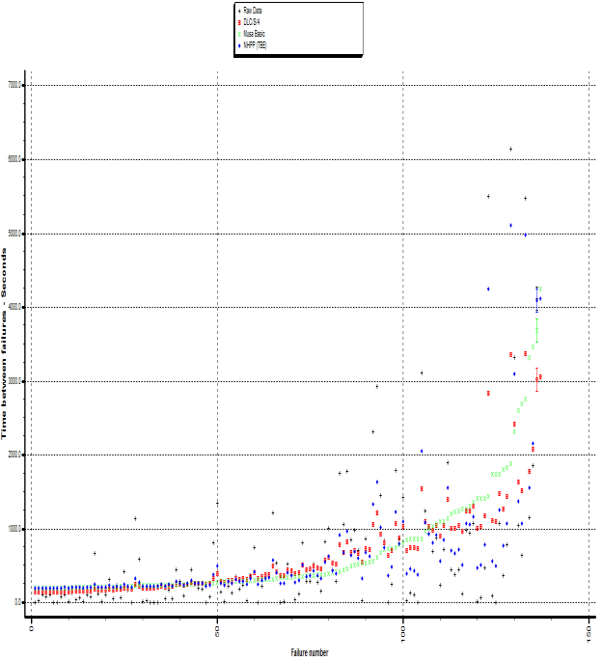
Data Used
In this study the data used is time-domain failure data for real time control system in the automotive domain.
The data has 136 faults reported with their time-between-failures (TBF) in milli-sec is listed in the figure in the previous slide.
The graph between Time-Between-Failure and Failure number of the data used in this study is shown in the figure.

Slide 7
Background of SRGM: Software Reliability Growth Model
Software reliability models can be classified in two types,
Early software reliability prediction models, which are static models making use of software attributes to predict important reliability related indices
Software reliability models which use statistical distributions of the failure inflow pattern to assess the reliability as a function of time besides estimating important reliability related parameters.
Another Classification of models can be
Black Box models
White Box models
Black-box models are used for software reliability estimation represented through statistical distributions as they do not need access to the source code, they are easy to adopt and can be applied widely.

Slide 8
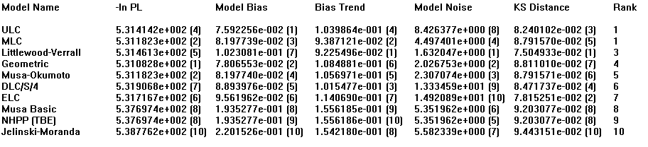
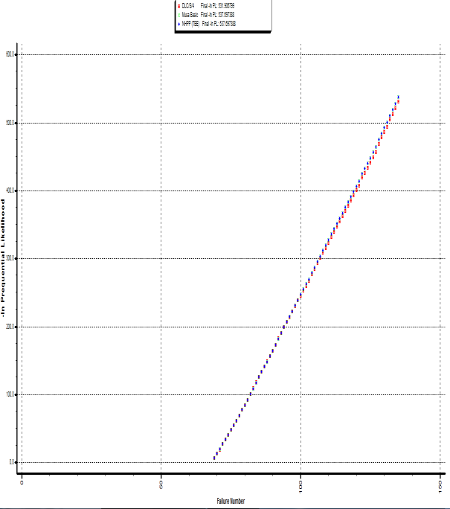
Model Selection
Selection of a software reliability model for use in a particular case has been an area of interest for researchers in the field of software reliability.
In this work, ten models have been analysed. An example of comparing models by analyzing prequential likelihood values is demonstrated in the figures alongside.

Slide 9
Parameter Estimation
Three methods commonly used for parameter estimation when using SRGMs are method of least squares, maximum likelihood estimation and method of moments.
Parameter estimation using Maximum likelihood estimation (MLE) involves solving couple of simultaneous equations to maximize the likelihood of defect data coming from given model equation to find the parameters.
The least square estimation uses curve fitting to the observed data for assessing unknown parameters. The least square estimation usually leads to using non-linear regression (NLR) for estimating the unknown parameters.

Slide 10
Techniques adopted for Analysis of Failure Data
All the data analysis techniques and equations used for analysis in this study are detailed in this section.
To estimate parameters using MLE a package for statistical environment “R” was used.
To estimate parameters using least count method the Non-Linear Regression routine available in statistical package IBM SPSS. The initial values provided were (α = 120 and b = 0.0001) and iterations continued until successive residual errors difference was less than 1.0E-08.
In order to make a stronger comparison of the two estimators, we use the non-linear simultaneous equations for obtaining the solution using MLE.

Slide 11


Equations for Goel-Okumoto model:
Equations for Delayed S-shaped model:
Where n is number of failures reported; time-between-failure is represented as { = 1, 2, …., n} and time to failure is given by = (cumulative time-between-failure). Equations are solved simultaneously to obtain the point estimates of parameters ‘a’ and ‘b’.

Slide 12
Comparison of asymptote prediction accuracy is done using the metric Prediction-Relative-Error (PRE).
PRE is the ratio between predicted error (predicted minus the actual asymptote) to the predicted number of failures.
PRE=
PRE settles a common problem using relative error for comparison between prediction by different models.
The relative error is the ratio of prediction error to actual value and thus if the predicted value is much larger than the actual value, relative error may be greater than 100%.
A comparative scale between [-1 1] or [-100% 100%] is provided by PRE.
The only major problem with PRE is that it provides asymmetric value based on over and under prediction.

Slide 13

To make the above PRE values symmetric and thus give consistent value for over and under estimation we use BPRE. BPRE stands for Balanced-Predicted-Relative-Error:
BPRE=
There exists a balanced error metric , also known as Balanced Relative Error proposed by Miyazaki et al. and BREbias defined as:
or BREbais=
Mean Square Error (MSE) is used to compare the model fitting to data for both fit and predicted values. The Mean Square Error measures the average deviations between predicted and actual values.
MSE=

Slide 14

Results and Discussions
The table details model-wise prediction of the asymptote (number of faults) and it is observed that maximum likelihood estimator (MLE) gives consistent results for the models as compared to the predictions using nonlinear regression (NLR) that varies much more with minimum prediction being 103 for Delayed S-shaped model and 114 for the GO model.
It can also be noted that for both asymptote and growth rate, our estimates using MLE are very close to the parameters estimates obtained using MLE simultaneous equations mentioned earlier.

Slide 15
BPRE
PRE

Slide 16
It is noted from the chart that all but one estimate under predicts for given dataset.
PRE and BPRE values were used for same parameter predictions it can be seen that BPRE provides with a better and more accurate representation of undervalued asymptote prediction as described earlier.
On the other hand the unbiased predictive relative error values for NLR estimators is comparatively higher closer to but under negative 20% for different models.

Slide 17
It is observed that MSE fit values using NLR are much better compared to values we got using MLE.
It is a known fact that least square procedure actually minimizes the sum of square of errors between the observed data and used model.
Another point to be noted from the comparison is that although NLR is giving very good fit values, it does comparatively worse for the MSE values for the predicted values.
Although SSE (Sum of Squared Errors)/MSE is not a completely fair comparison parameter between MLE and NLR for the fitted data points, but as MSE for the predicted data is not optimized for both MLE and NLR, it basically compares between the two, MLE and NLR on evaluating fit of given model to observed data and goodness-of-fit to predicted data.

Slide 18
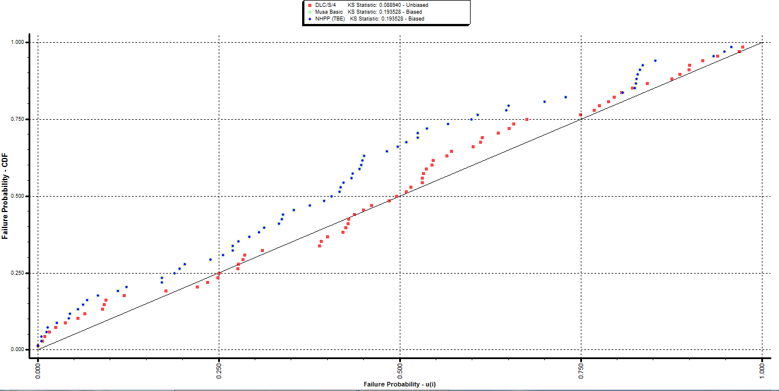
Which Estimators give Better Fit to Data and Predicted values?
A widely used parameter to compare various models and their estimators for their work is their ability to fit the noted defect data or failure data and to the predicted data.
The graph shows model-wise bias plot depicting automotive software failure probability.
The graph depicts that two models are biased with KS statics equal to 0.193528 and one model is unbiased with KS statics equal to 0.08894.

Slide 19
CONCLUSION
This study compares the most widely used and recommended methodologies to estimate parameters for the purpose of applying SRGMs to defect data or failure data from automotive software domain and access reliability later.
It is observed in the study that while MLE is the recommended estimator as it has superior statistical properties, its applicability and usability in all cases is doubtful.
Results shown here and properties of MLE and NLR estimators suggests that while NLR is good estimator for fitting the data to observed failure data, MLE is a better estimator in terms of making reliable predictions.

Slide 20
Thank you

